Slide 1
Leveraging Rancher Federal within the U.S. Government/Public Sector
Zack Brady – Field Engineer zack.brady@rancherfederal.com

Slide 2
Introductions/Overview
What’s a Container? Kubernetes?
Why Rancher Federal?
Open-Source Ecosystem
The Rancher Federal Approach
Demo/Workshop (my favorite)
Q&A Session
Today’s Agenda

Slide 3
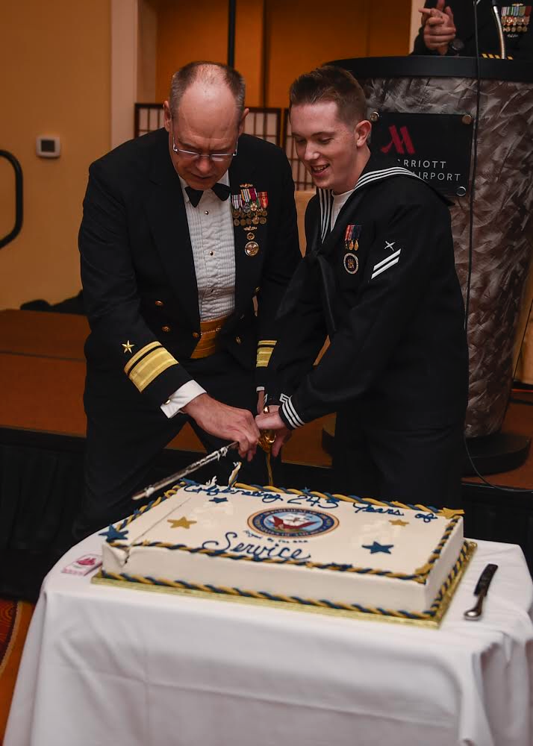
About me…
DoD/IC Contractor
U.S. Military Veteran
Built/Exited a Digital Firm
Open-Source Contributor
Career of Software/DevOps
Active Volunteer FF/EMT
Zack Brady – Field Engineer zack.brady@rancherfederal.com

Slide 4
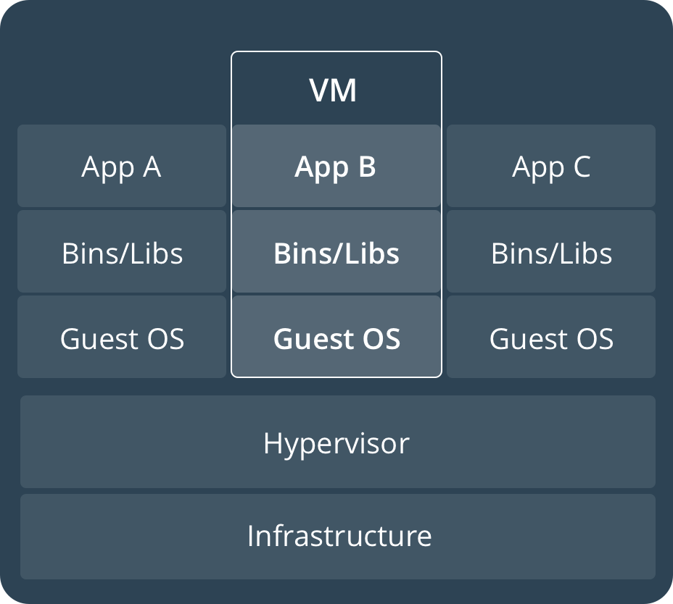
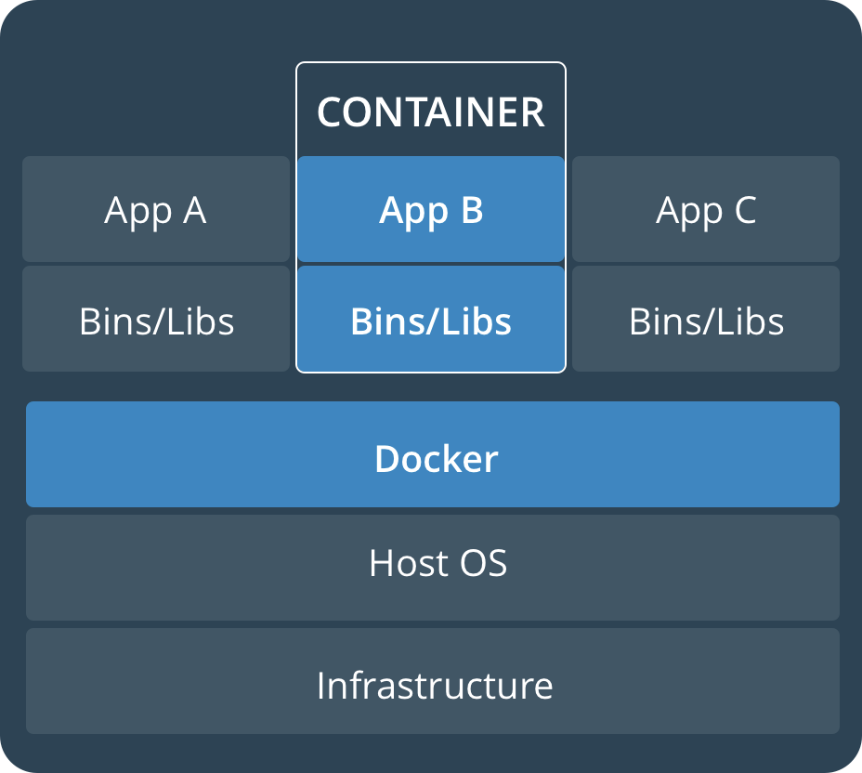
VMs? Containers? Kubernetes!

Slide 5
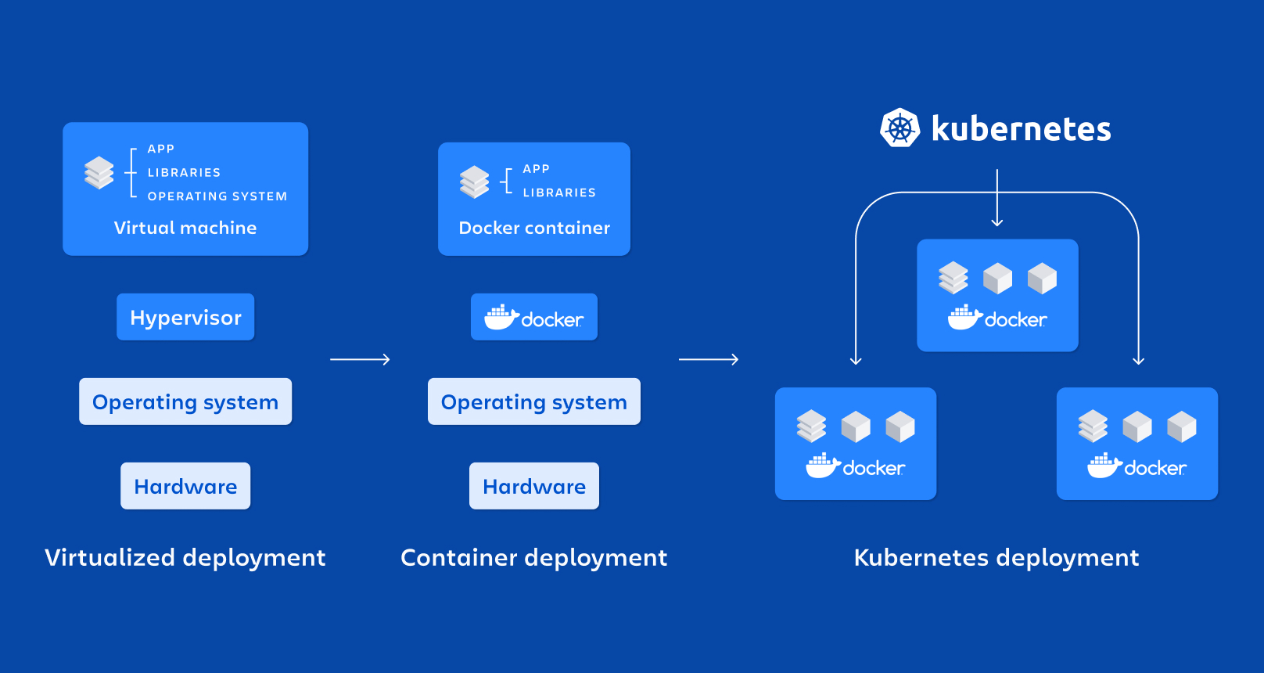
VMs? Containers? Kubernetes!

Slide 6
What is Rancher Federal? (RGS)
Rancher Federal is a 100% U.S. entity dedicated to delivering Kubernetes and Cloud Native Technology solutions and support across the Federal, DoD/IC, and Public Sector community.
Rancher Federal (RGS) offers varying levels of service and support subscriptions, including U.S. based CONUS Support and Cleared Support (Full-Time, Part-Time, and Contract).
Rancher Federal (RGS) exists to enhance Rancher’s capabilities to meet the ever-evolving Federal, Department of Defense, Intelligence Community, and Public Sector mission requirements by:
PKI Authentication
STIG/CIS Benchmarks Hardening
SELinux/FIPS Compliance
Enterprise Auditing Functionality
C2S, SC2S, GovCloud, Airgapped, and Special Enclave Support
Automated Upstream Image Vulnerability Scanning

Slide 7



Rancher’s Pillars of Success
Enterprise Support
24/7 U.S. Enterprise Support for Rancher & Ecosystem
Technical Account Manager & Bootstrap Architecture and Infrastructure Support
Fully Cleared Support
70% of RGS is TS//SCI
Key Industry Partnerships
Continuous Training (CE)
Mission Accelerator
Dedicated to the Rancher Portfolio to work for Airgap, Classified, and Mission
Security-first mindset to the Rancher capabilities by baking in NIST FIPS-140-2/3 Encryption and DISA STIG certification
Collaborated to develop the RKE Gov/RKE2 secure-by-default Kubernetes distribution
Professional Services
Fully Onsite or Remote FTE and Temporary Engineers
Cloud Advocates and Evangelists focused on bootstrapping or delivering customer success
Multiple Prime Contracts around the IC/DoD
Primed at USAF Platform One

Slide 8













Rancher SLA
Authentication & Authorization
App Management & CI/CD
Monitoring & Logging
The Complete Rancher Ecosystem
Registry & Image Scanning
*
Container Security & Secrets
Networking & Service Mesh
*
Platforms & Orchestration
Container Engine
*
Persistent Storage
Operating Systems
Infrastructure Drivers

Slide 9































Rancher Supported Partners
Rancher SLA
Certified Integrations
Authentication & Authorization
*
App Management & CI/CD
Monitoring & Logging
Registry & Image Scanning
Container Security & Secrets
Networking & Service Mesh
Platforms & Orchestration
GKE
AKS
Container Engine
Persistent Storage
Operating Systems
Infrastructure Drivers

Slide 10

















Stressed about STIG’s? Worried about ATO’s?

Slide 11

Break!!
and then our…
Demo/Workshop!
https://workshop.rancherfederal.io/

Slide 12
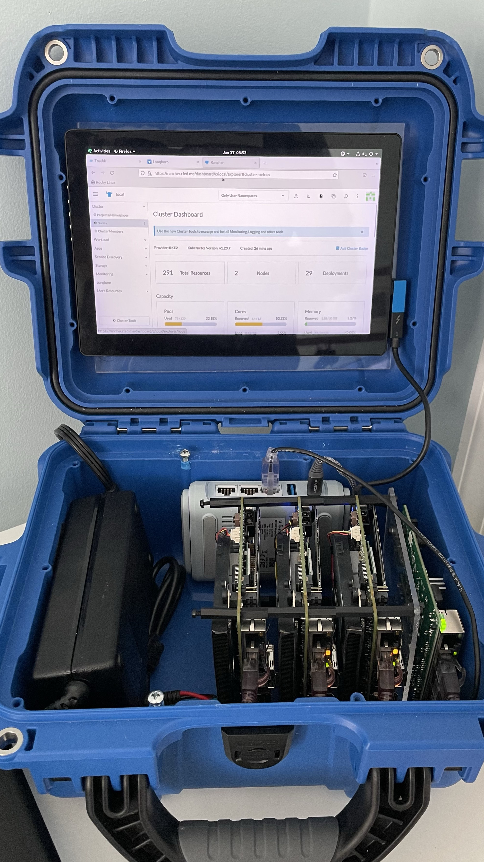
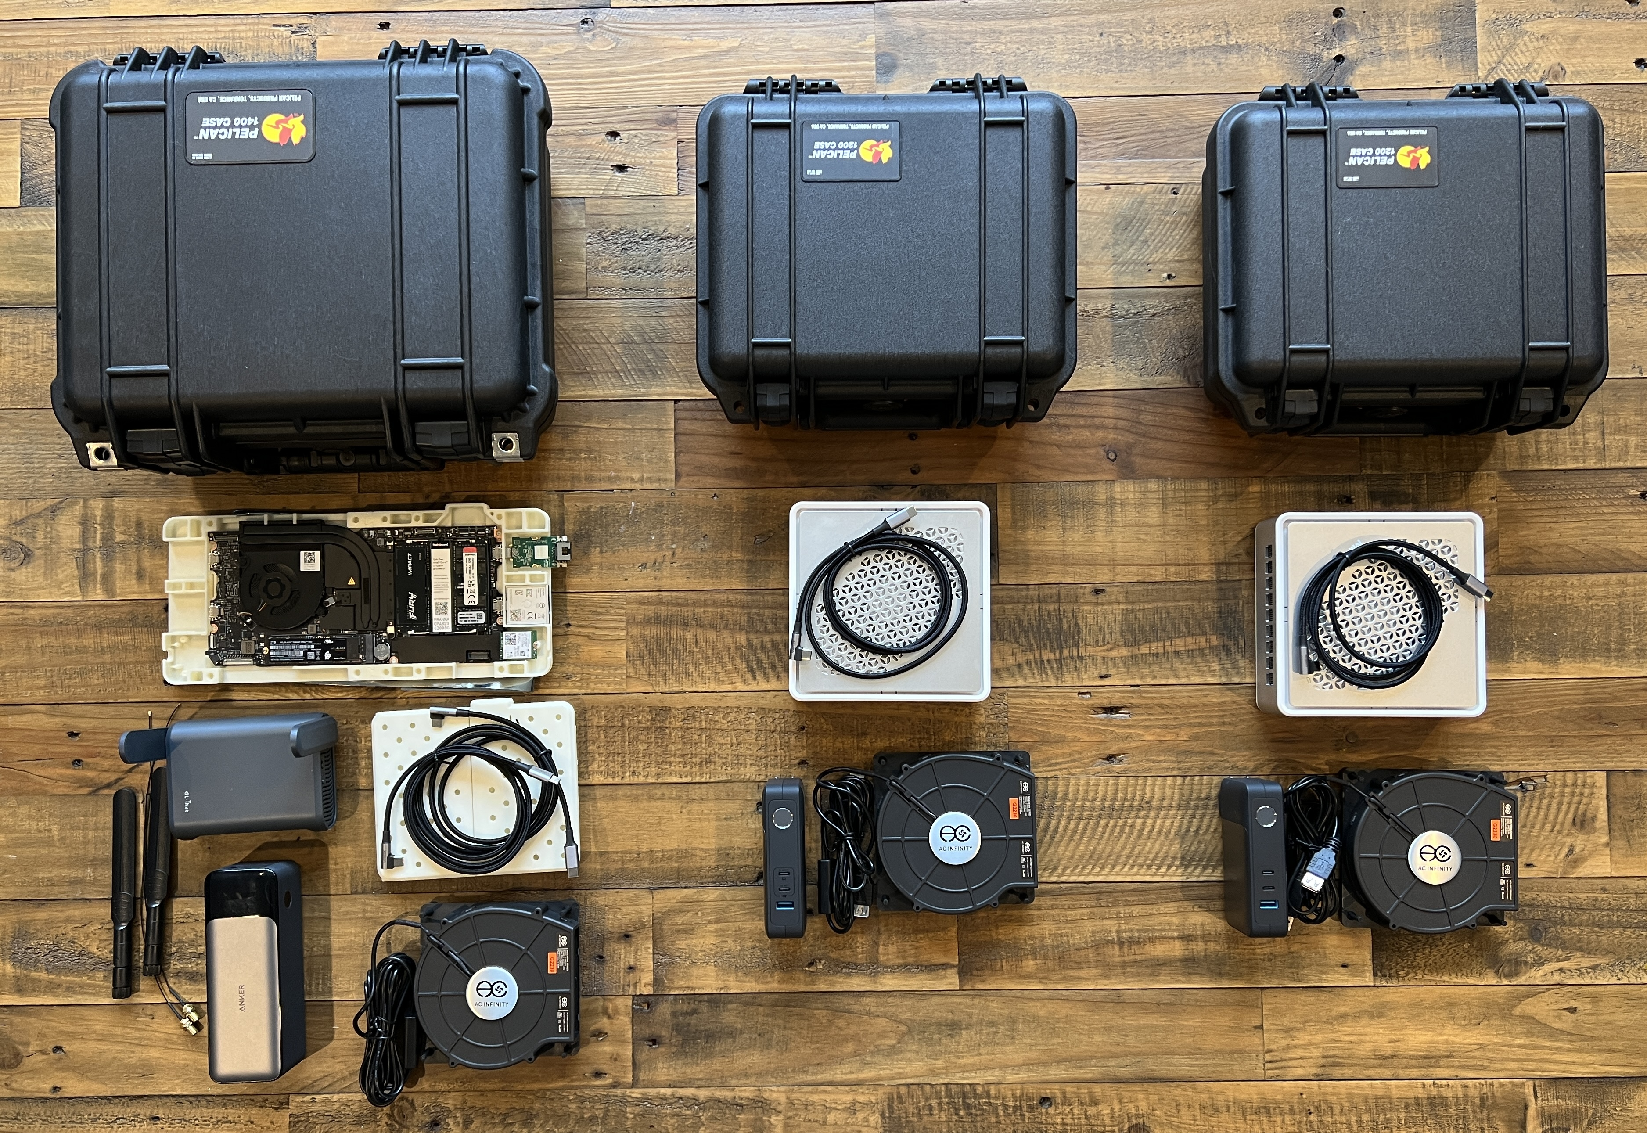
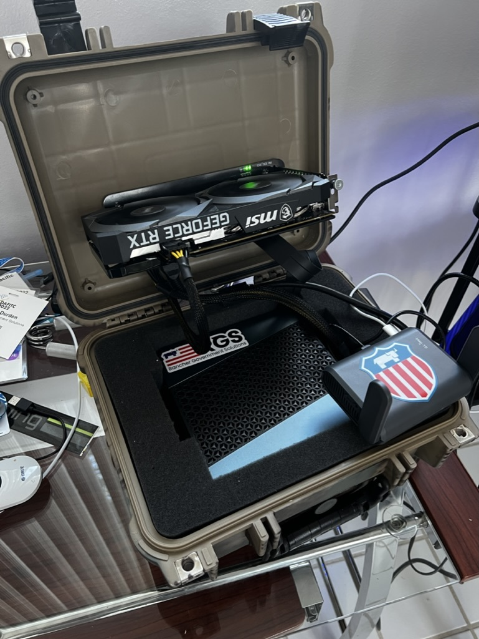
From Datacenters to the Edge…

Slide 13
Rancher Federal and Amazon AWS
Rancher is the leading Kubernetes distribution and Kubernetes platform.
Amazon AWS is the leading and most adopted cloud provider.
But what does that mean for our customers?
Rancher Federal and Amazon AWS have partnered together to develop a marketplace offering to dramatically reduce the barrier to entry to Kubernetes.
This offering is a highly available free trial of RKE2 and Rancher Manager on AWS GovCloud (US), designed strictly for use only by U.S. Federal Government and U.S. Public Sector Customers.
http://tryranchergov.com/
https://github.com/zackbradys/rancher-on-aws

Slide 14
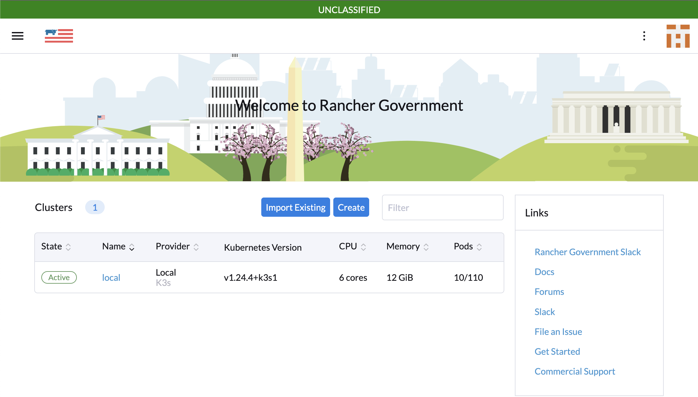
What’s Next for Rancher Federal…
Rancher Carbide
Secure and Trusted Container Registry (Azure Gov)
Government STIG Validation (STIGATRON)
Supply Chain Management (SUPPLYATRON)
Offline Rancher Docs
SLSA3/SBOMs/Scans
Built for our U.S. Government Support Customers (Licensed)

Slide 15
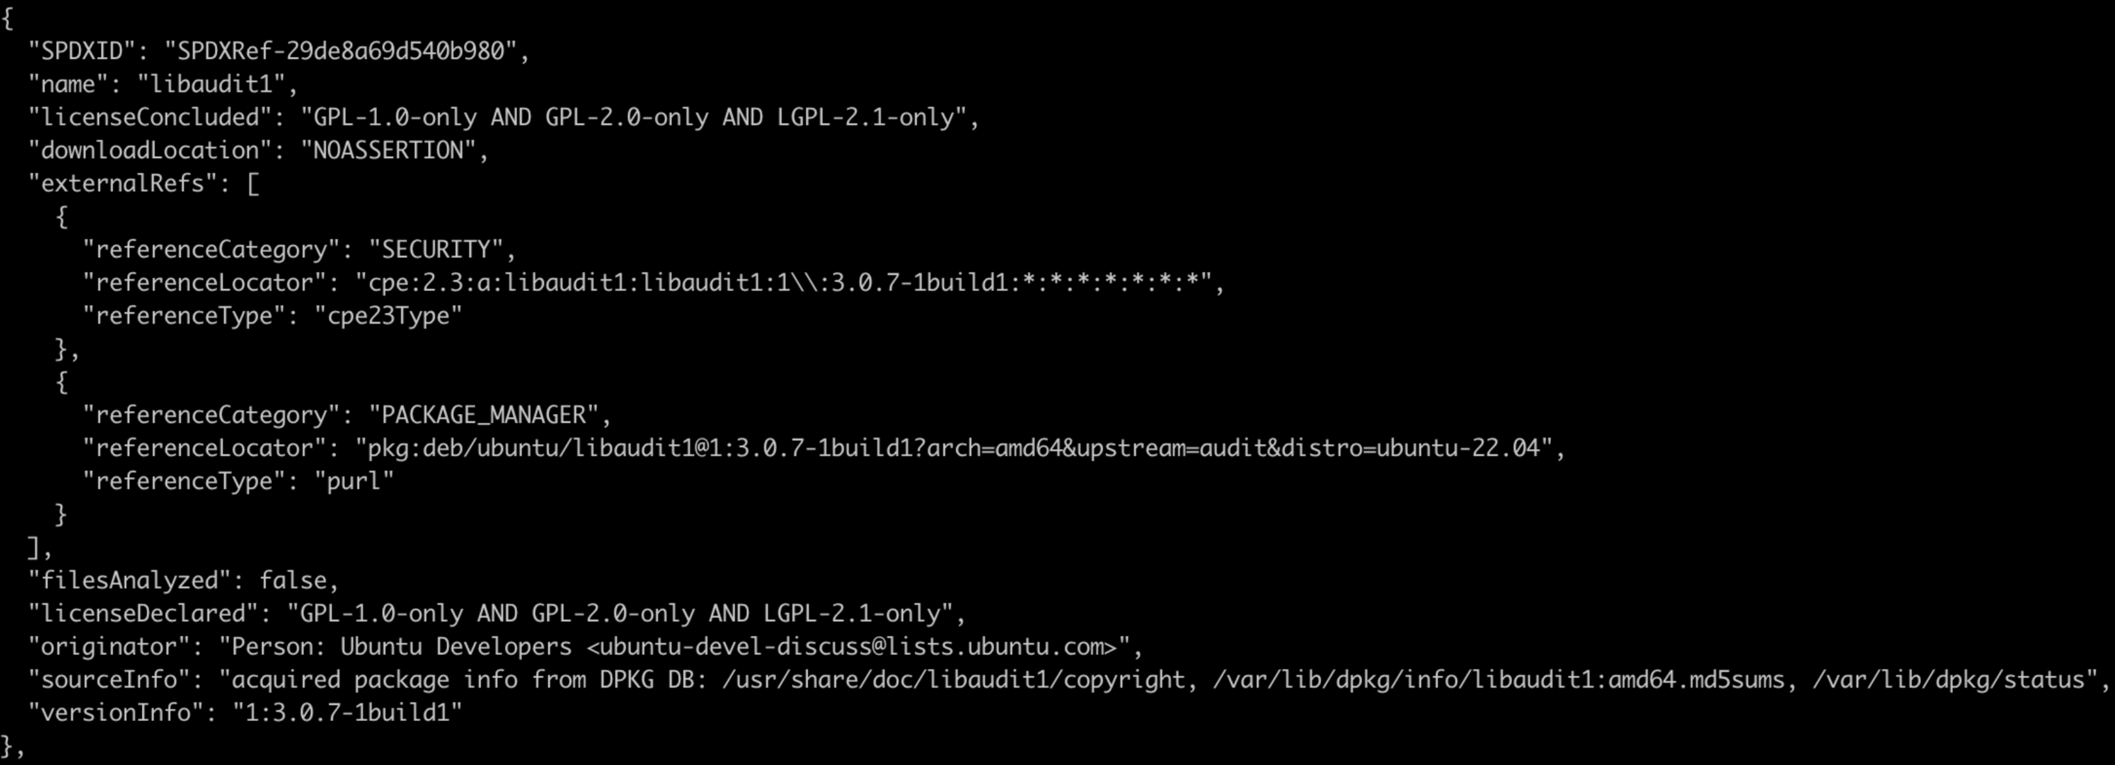
Software Bill of Materials (SBOMs)

Slide 16
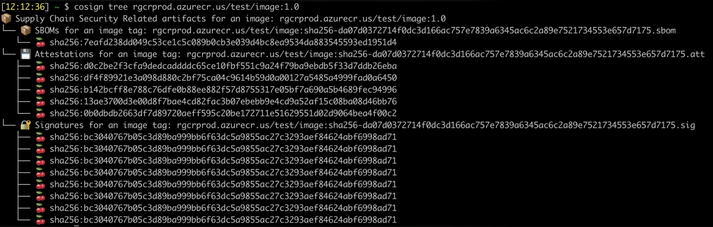
Image Attestation Reports

Slide 17
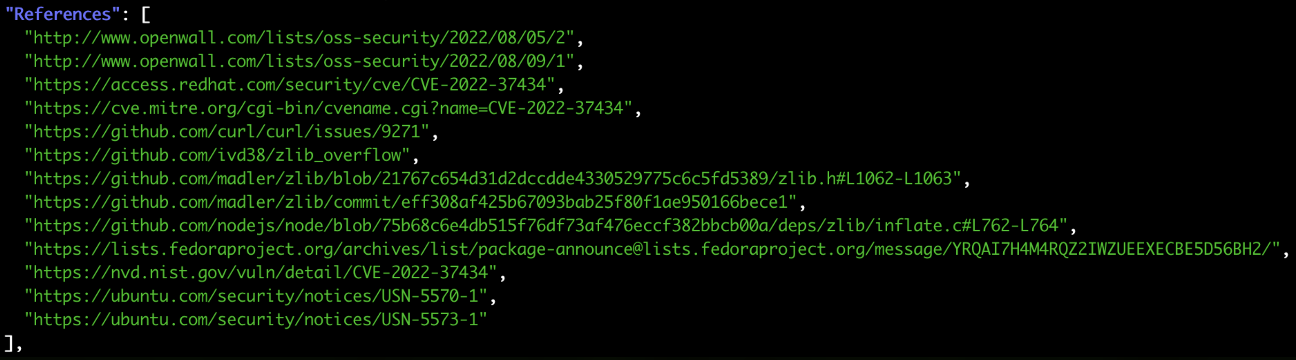
Image Vulnerability Scans

Slide 18
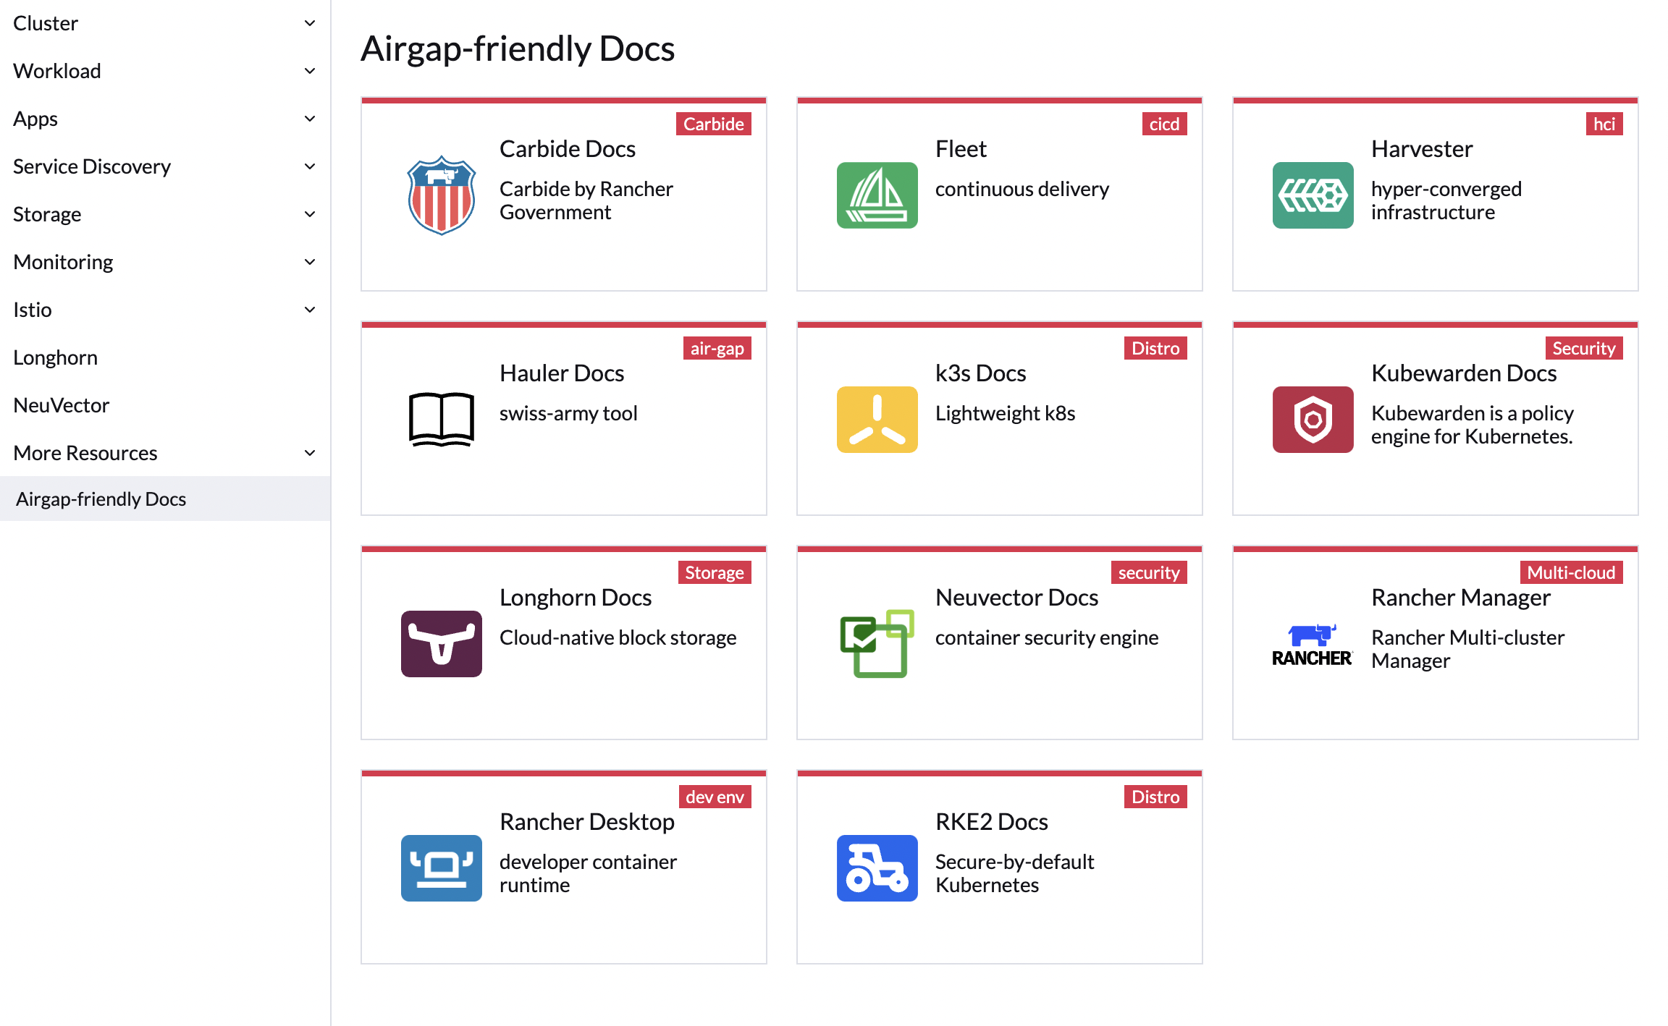
Offline Rancher Docs
18

Slide 19
Thank you for your time today!
Email: zack.brady@rancherfederal.com
GitHub: https://github.com/zackbradys
Website: https://ranchergovernment.com
Cage Code: 8GLZ3
DUNS: 117387835

